Slide 1
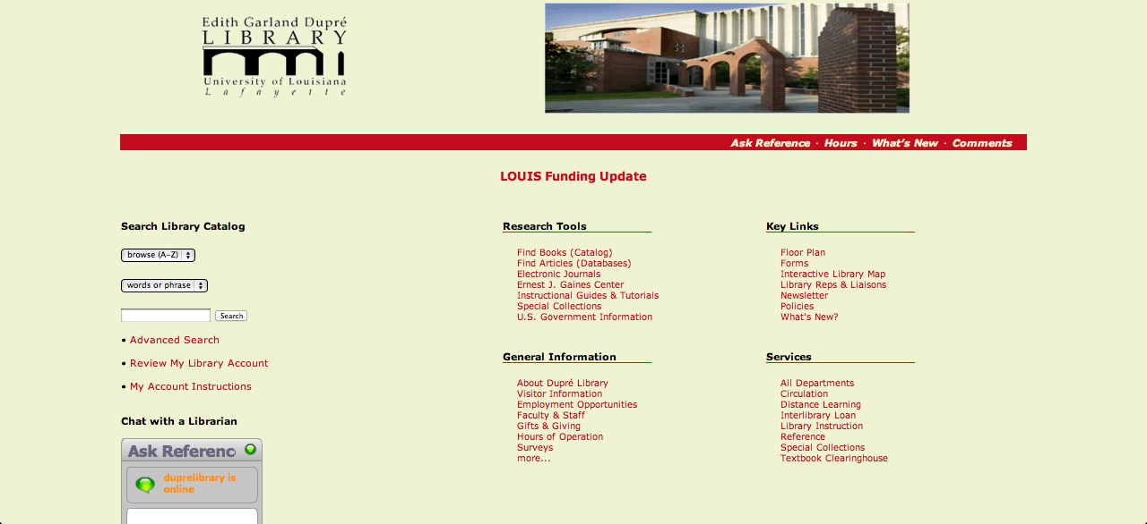
Where is the title of the page ?
Where is the pathway, showing where we are ?
Lack of visibility: read everything to find ‘hours of operation’
Notes:
1 – Visibility of system status
When you go to the library page of the university, the title and the pathway will be missing. You don’t know exactly where you are. According to Nielsen’s criteria, “the system should always keep users informed about what is going on” . So, on this specific page this criteria is not respected.
What’s more, we tried to find the hours of operation, but before find it, you have to read all main sections to see it. The architecture of information is not well organized and so the main information is hidden.

Slide 2
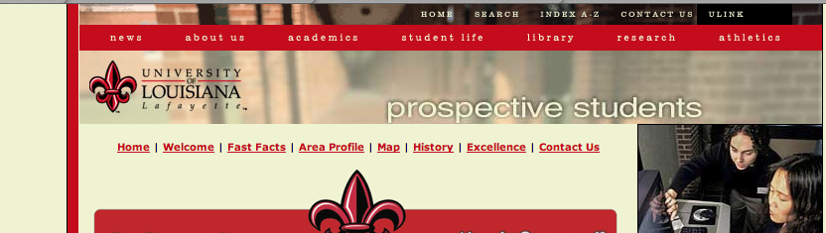

By mousing over we don’t know if it‘s a single label or a unit with the others because no change of color
Notes:
1 – Visibility of system status
By mousing over the different labels on the menu bar, we don’t know which one is activated. Any of these is coloring by mousing over. So, we have to click in order to see if we are in the good page. Moreover, this menu bar is small one at the top of the page, just above another one. We think that the location is a bad move (lack of visibility).

Slide 3
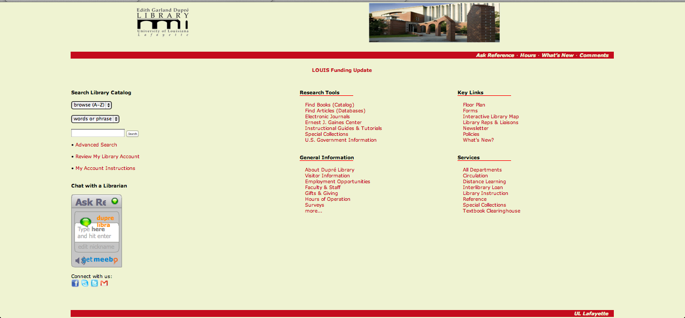
Where is the button home page ?
Notes:
3 – User control and freedom
Usually, in order to facilitate the navigation of users website designers create a home page button on each page. This button is called “emergency exit”, and it is a simple way to let users feel in control of your site.

Slide 4

Redundancy?
What is the solution?
Consistency or inconsistency?
Notes:
4 – Consistency and standards
On the one hand this page is interesting because this layout is the same for each section (Prospective student, current students, Almuni… see menu on the left). So, you can easily navigate in the website. But on the other hand it’s flimsy because there is redundancy and we have to remember that we are on the page. To avoid this problem the solution should be italicize the label in the menu on the left to show at the users that they are on this page.

Slide 5
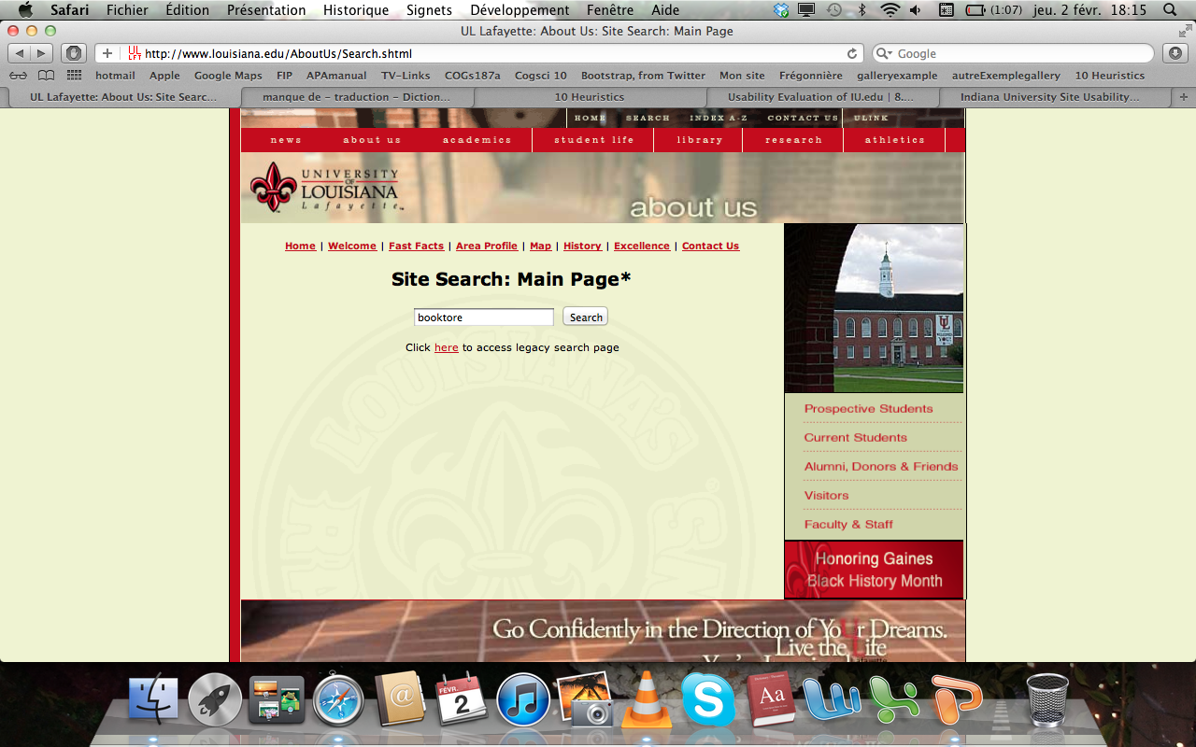
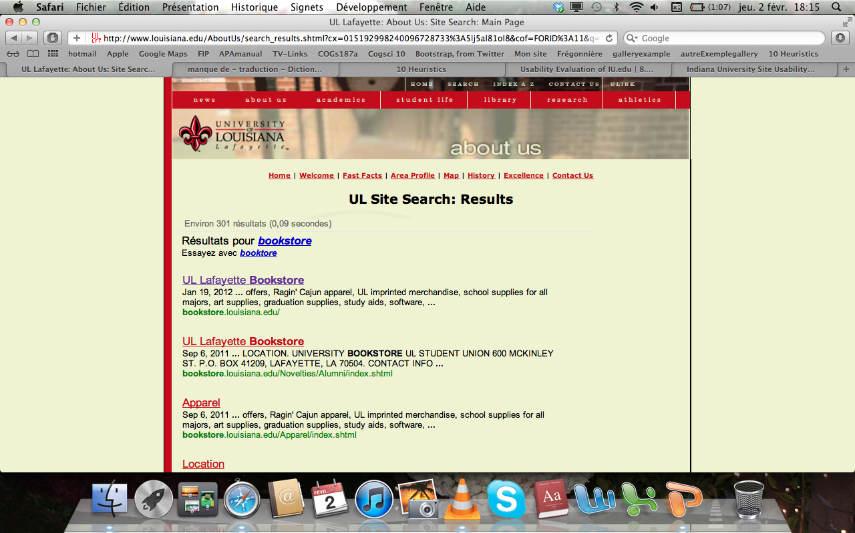
Notes:
5 – Error Prevention
We tried to defy the search system of the website, but we didn’t succeed. Entering’ booktore’ instead of ‘bookstore’ is scoped and corrected by the system.
The system warms we realized an error and tries to find the good word.

Slide 6
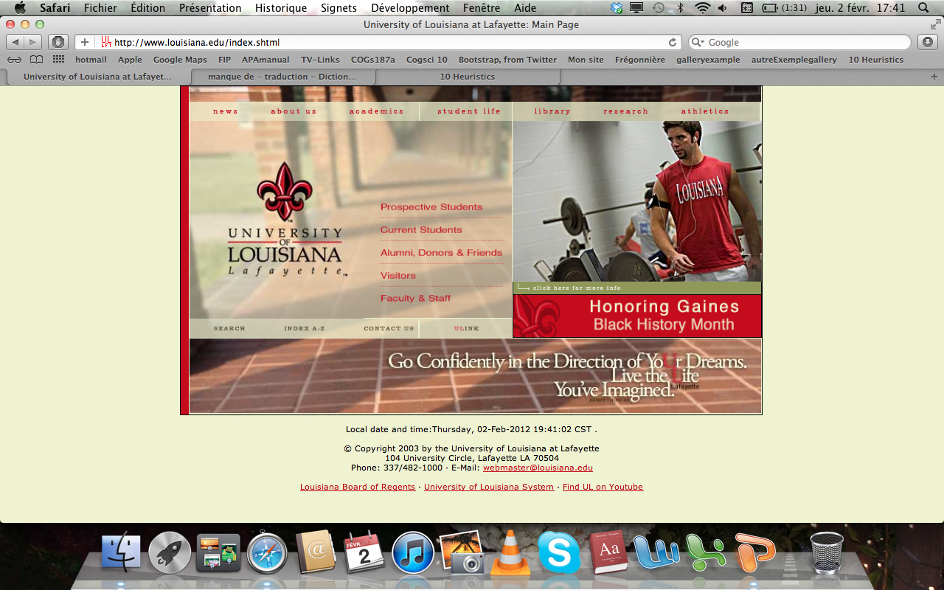
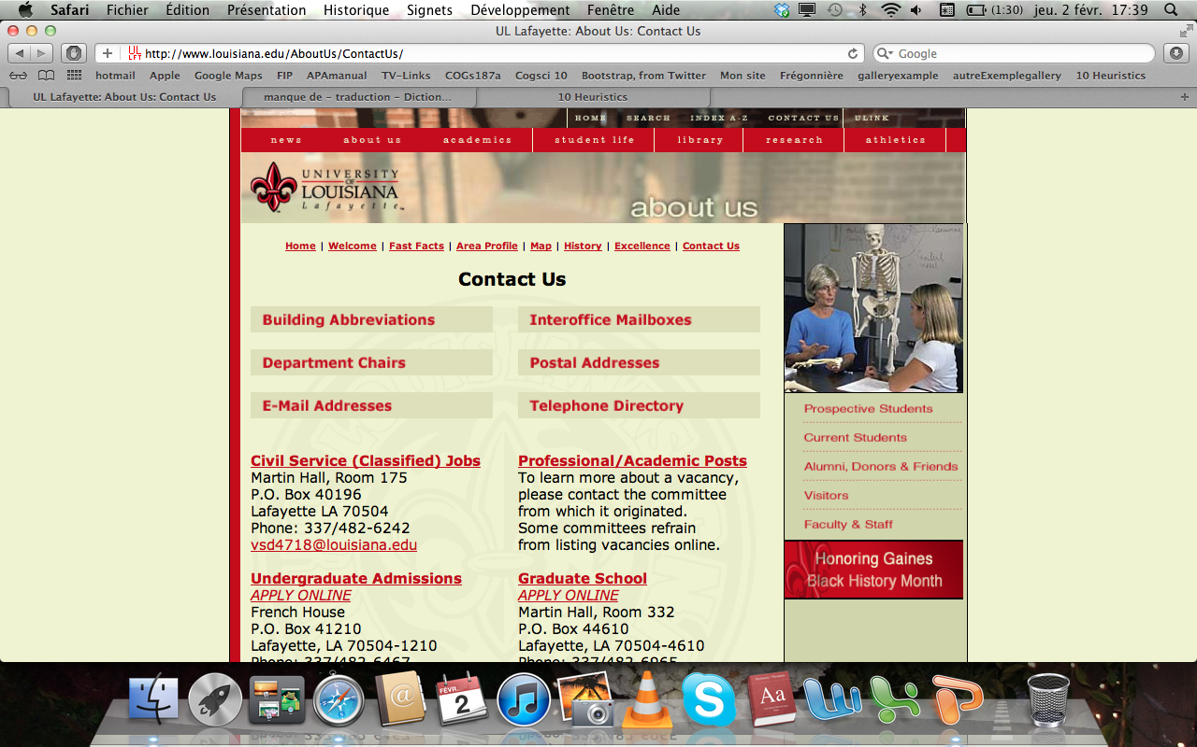
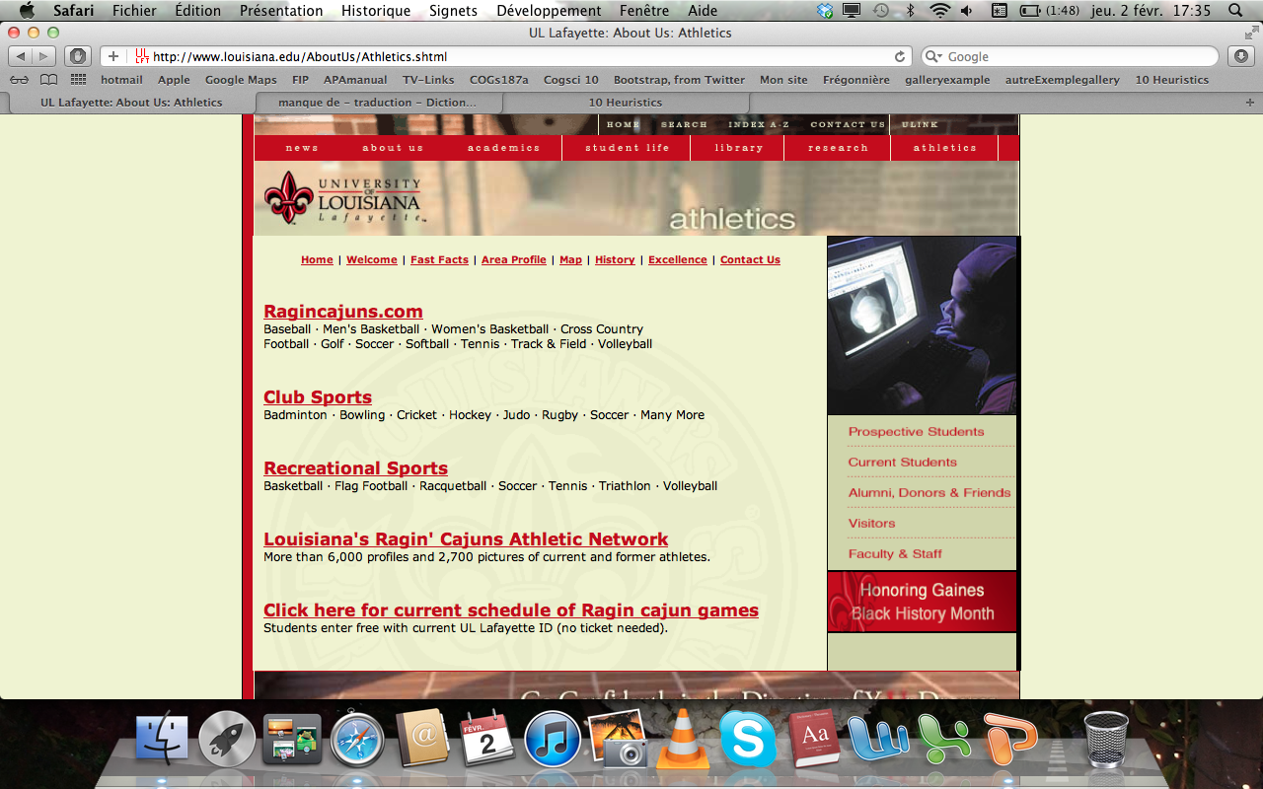
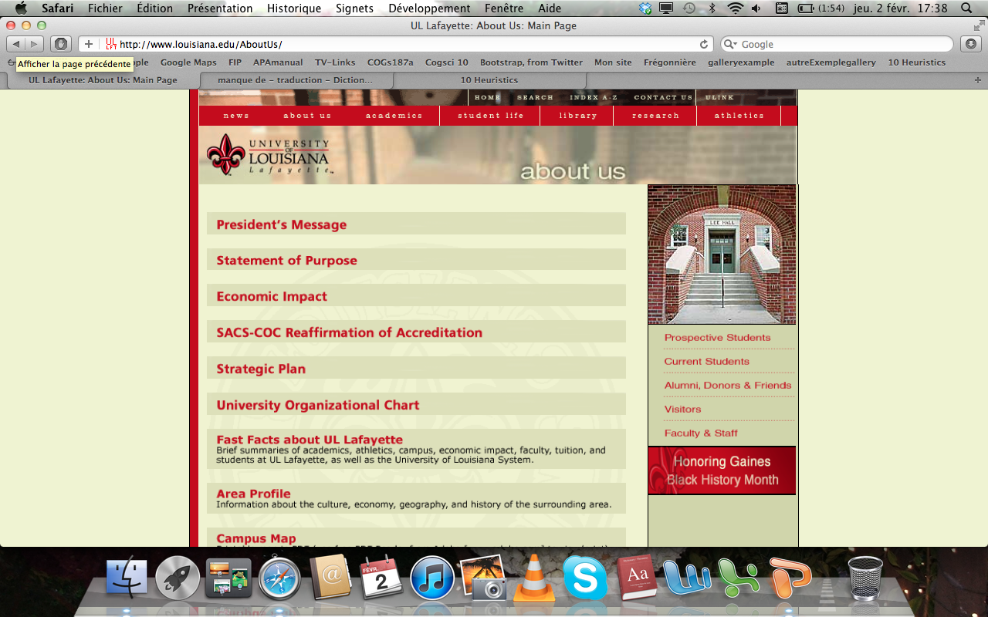
Notes:
5 – Error prevention
It’s funny because on this page there are two times the same information: home link and contact us link. But the contact us, in both cases go to the same page whereas the home link go on the hand to the home page and on the other hand to the page about us. So, we don’t really understand why there is a difference because the page ‘about us’ is not the home page of athletics section…
In this situation nothing alerts the users that the home button is not the home page button of the website.

Slide 7
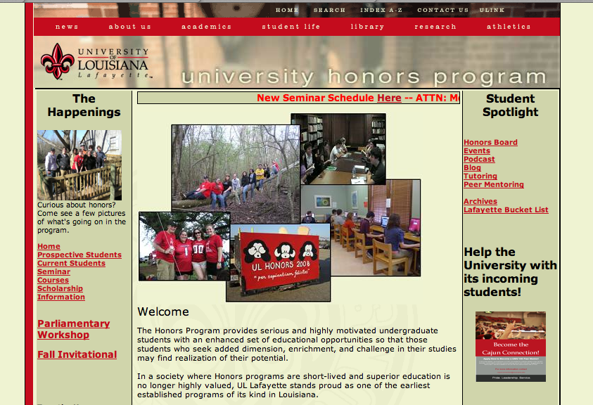
Where is the pathway to get there on this specific page? We have to remember how we got there.
Notes:
6 – Recognition rather than recall
What’s the difference between recognition and recall? For instance, recognition consists of remembering have already seen this person whereas recall consists of remembering her name. So, what’s why recognition is better than recall for website designers: the users don’t have to remember their actions.
The pages on this site have labels that indicate where you are but you don’t remember how you got there (example university honors program page). The user is forced to remember how he got there himself. And we know that recognition criteria is better than recall criteria. Human can only remember 7⁺⁻² items in the same time. So, cerate a pathway at the top of each page could be a good solution to improve the recognition criteria.

Slide 8
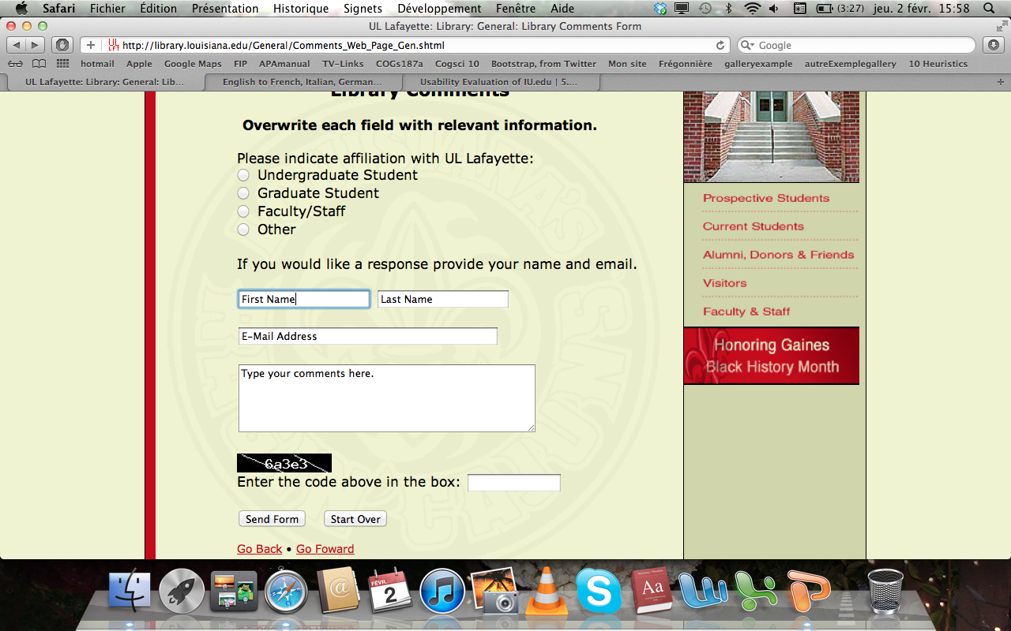

When I saw this form the first thing that I did was to enter my first name but you have to delete the title before enter your personal information.
Notes:
7 – Flexibility and efficiency of use
Forms are complex things and mostly ill-conceived. Here for instance, users have to delete the title of the field before enter their own information. We tried to enter our information without delete these titles, and we submitted: any message of errors !!! What’s why, we talk about inefficiency of use.

Slide 9
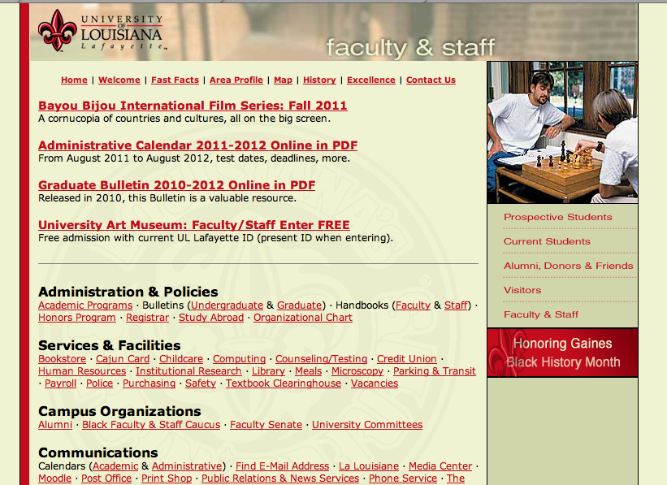
The content is just blocks of text and lists of facts. There is too much information. Separation of text would improve readability
Notes:
7 – Flexibility and efficiency of use
Almost each page has an inefficient layout. For instance on this page ‘faculty and staff’ the content is just blocks. You can’t see the main information and in the mood for search specific things. There is too much information. According to Nielsen, “every extra unit of information in a dialogue competes with the relevant units of information and diminishes their relative visibility. ”

Slide 10
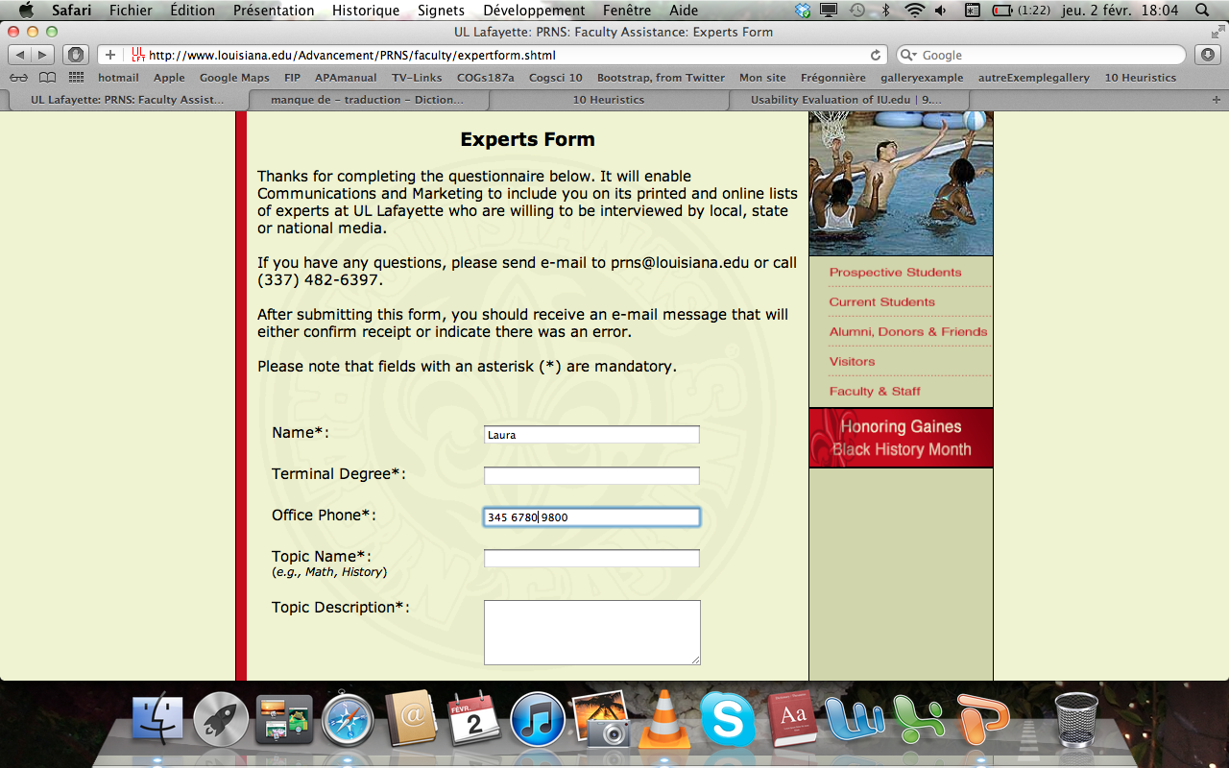
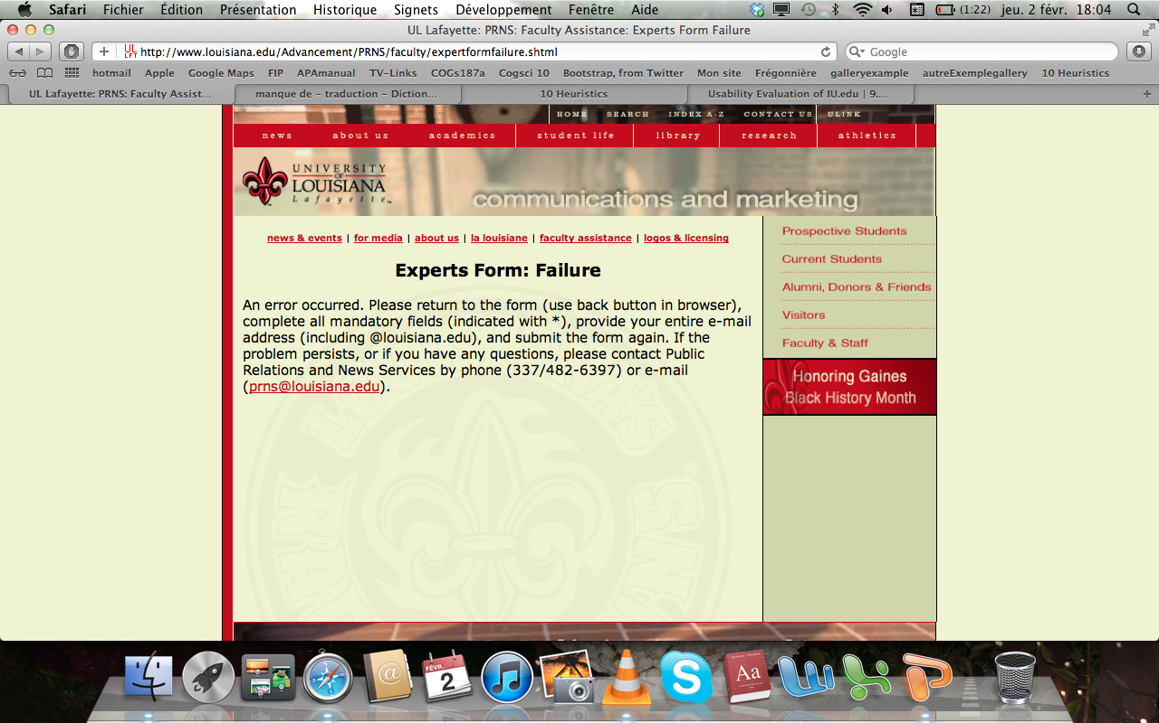
The system provides an appropriate solution and provides the users to completed their form.
Notes:
9 – Help users recognize, diagnose and recover from errors
In order to test their system, we forgot to fill in the required fields. But we can say that the system is efficient: a perfect solution is proposed to the users and we can even call the services to get some help.

Slide 11
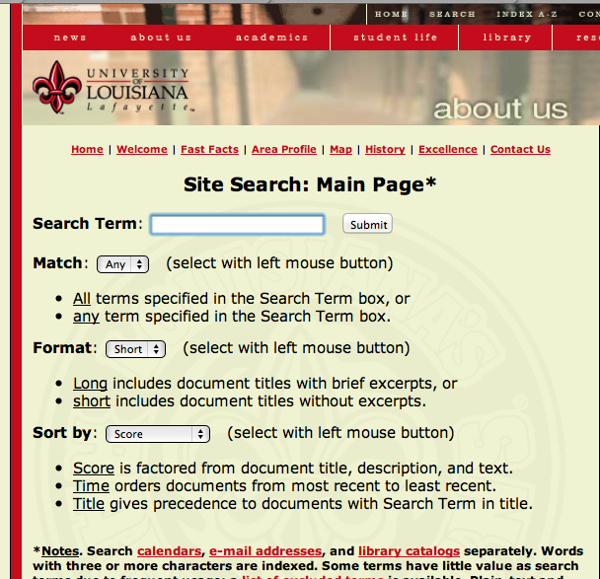
We can do specific search using the different properties: match, format and sort by. A documentation is available.
Notes:
10 – Help and documentation
The good point here is that we can do specific search in function of different criteria. A documentation to help users is available. But two main things are bad.
The first thing is that we enter your search term and then choose our specific criteria. It’s not a logical way because our specific criteria are dependant on our search term.
And what’s more the layout is very bad.

Slide 12
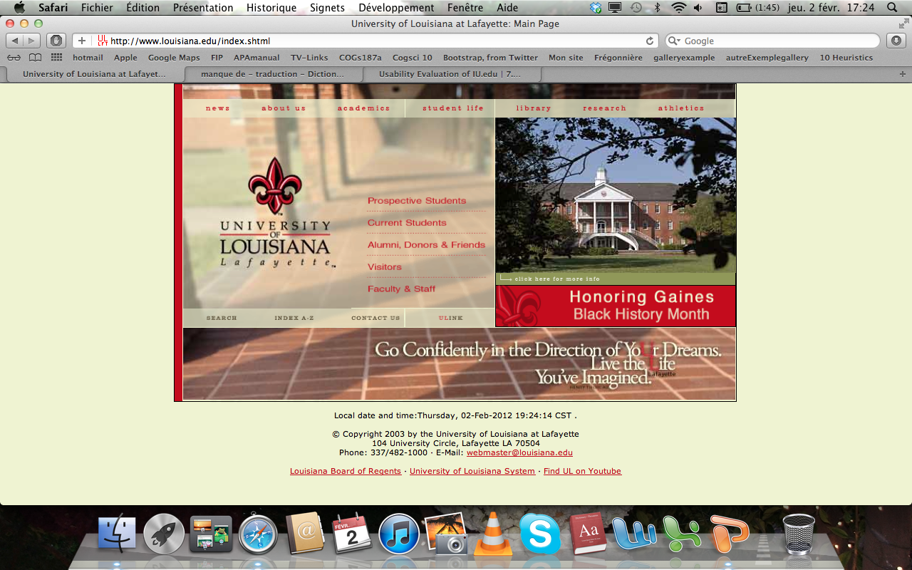
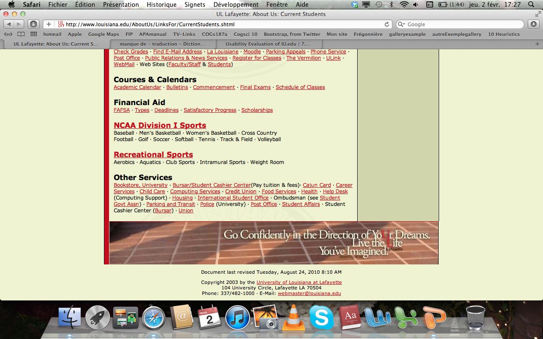
We can’t find the ‘site map’ of this website on every pages
Notes:
I don’t where put this one and criteria 2 and 8 missing
5 criteria idea = ne previent pas quand on tombe sur un autre site

